Slide 1
http://www.cdc.gov/niosh/talkingsafety/states/or/2015-153/default.html
NAD Summer Camp Staff Training
Angelina Cameron-Wood, Safety Volunteer
NAD Youth & Young Adults Ministries
Notes:
It is recommended that you work closely with your conference’s HR and Risk Management departments, and your conference’s Workers Comp representative to provide additional material to assist with safety in the work place.

Slide 2
Notes:
Video to introduce the topic of hazards. (Move your cursor onto the screen and click the start arrow)

Slide 3
What is a Hazard?
Notes:
Discuss this question with your Staff. Have your Camp Staff share with you what they think is a “Hazard”.

Slide 4
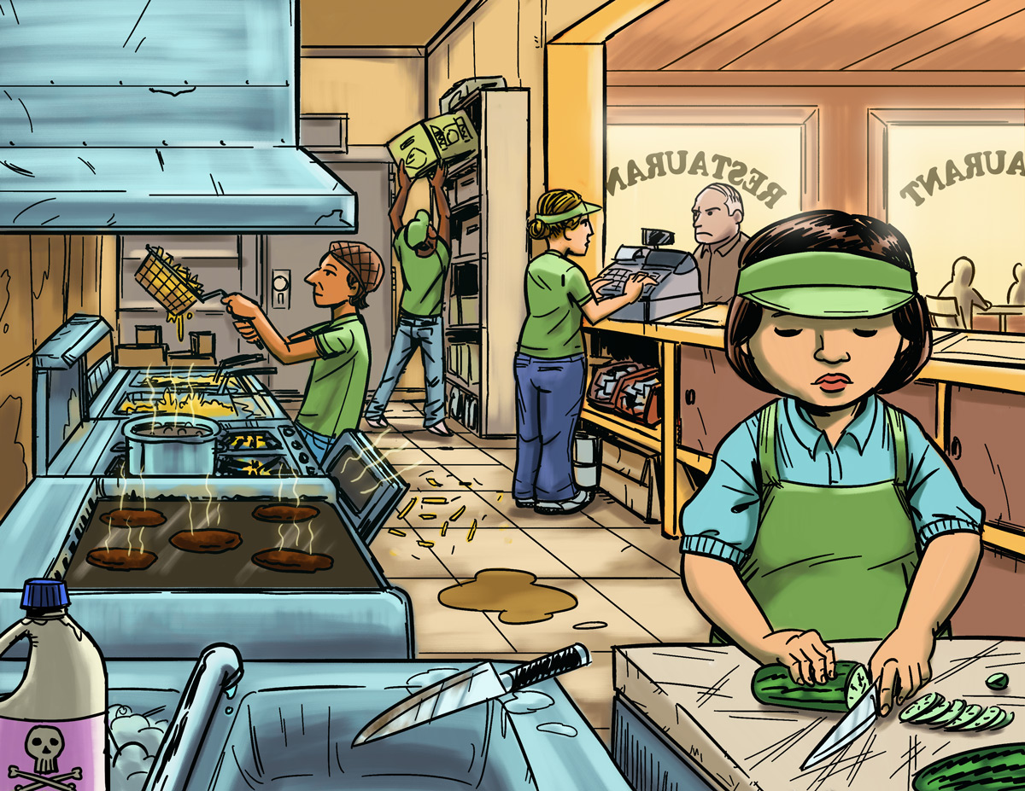
Find The Hazards: Camp Kitchen
a
http://www.cdc.gov/niosh/talkingsafety/states/or/2015-153/default.html
Notes:
Invite your Camp Staff to analyze the picture and share what they think is a work hazard. After you get the group participating, you as a trainer, emphasize items that are relevant to your Camp program.

Slide 5
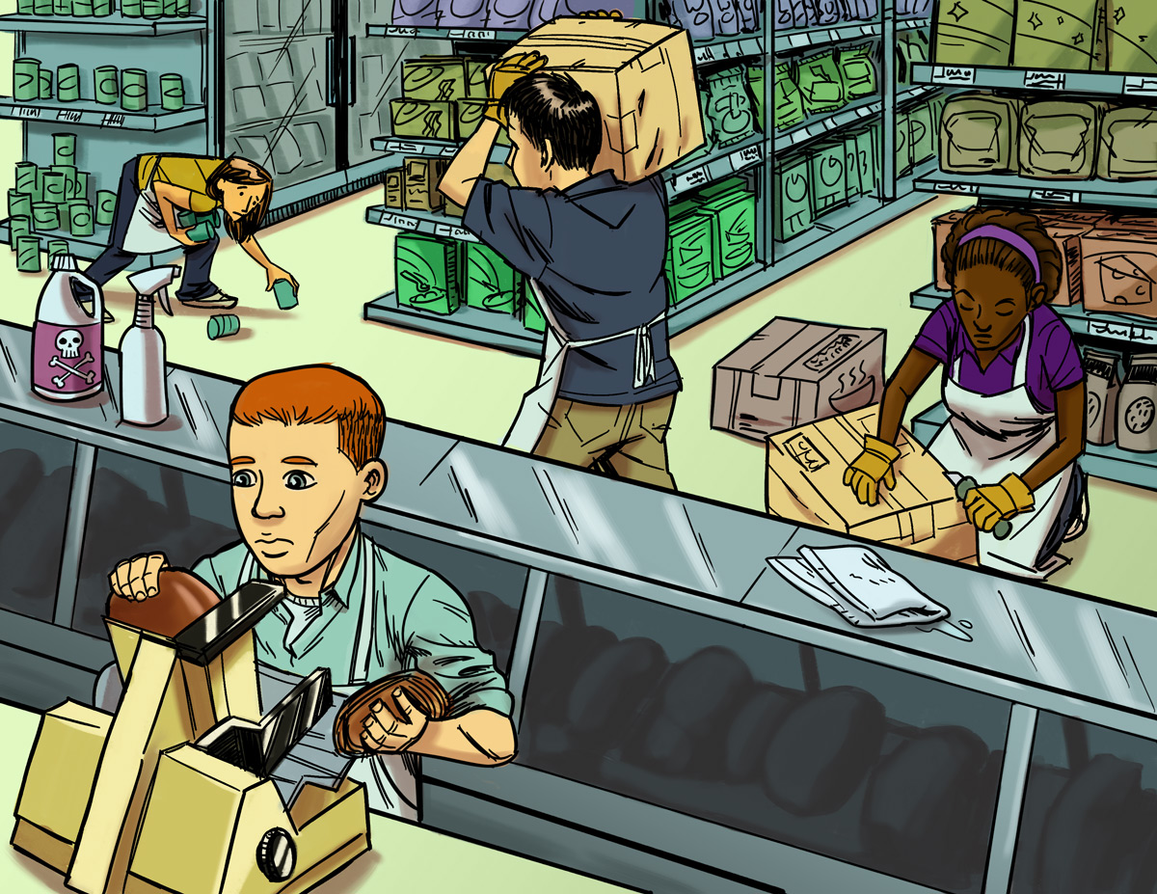
Find The Hazards: Camp Store
a
http://www.cdc.gov/niosh/talkingsafety/states/or/2015-153/default.html
Notes:
Invite your Camp Staff to analyze the picture and share what they think is a work hazard. After you get the group participating, you as a trainer, emphasize items that are relevant to your Camp program.

Slide 6
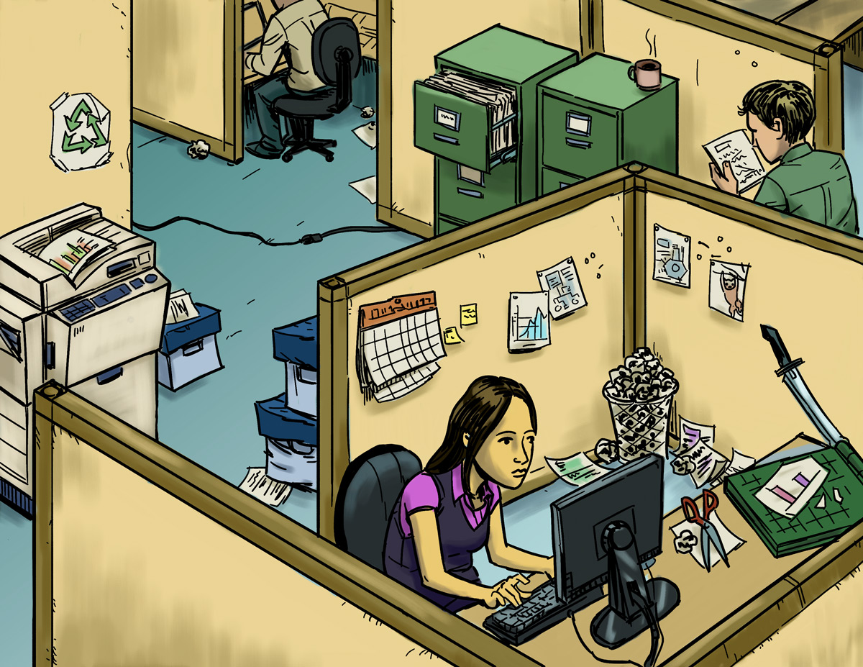
Find The Hazards: Camp Office
a
http://www.cdc.gov/niosh/talkingsafety/states/or/2015-153/default.html
Notes:
Invite your Camp Staff to analyze the picture and share what they think is a work hazard. After you get the group participating, you as a trainer, emphasize items that are relevant to your Camp program.

Slide 7
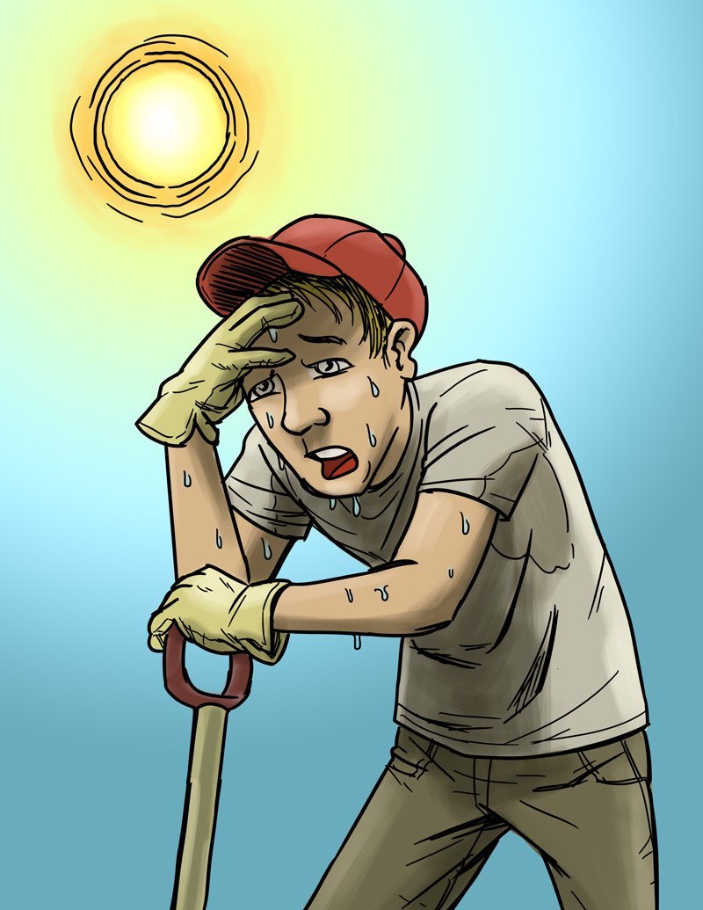
Eliminating or Reducing Hazards
http://www.cdc.gov/niosh/talkingsafety/states/or/2015-153/default.html
Notes:
Discuss with your Camp Staff on ways they can prevent becoming fatigued and over heated during the outdoors’ activities. After you get the group participating, you as a trainer, emphasize items that are relevant to your Camp program.

Slide 8
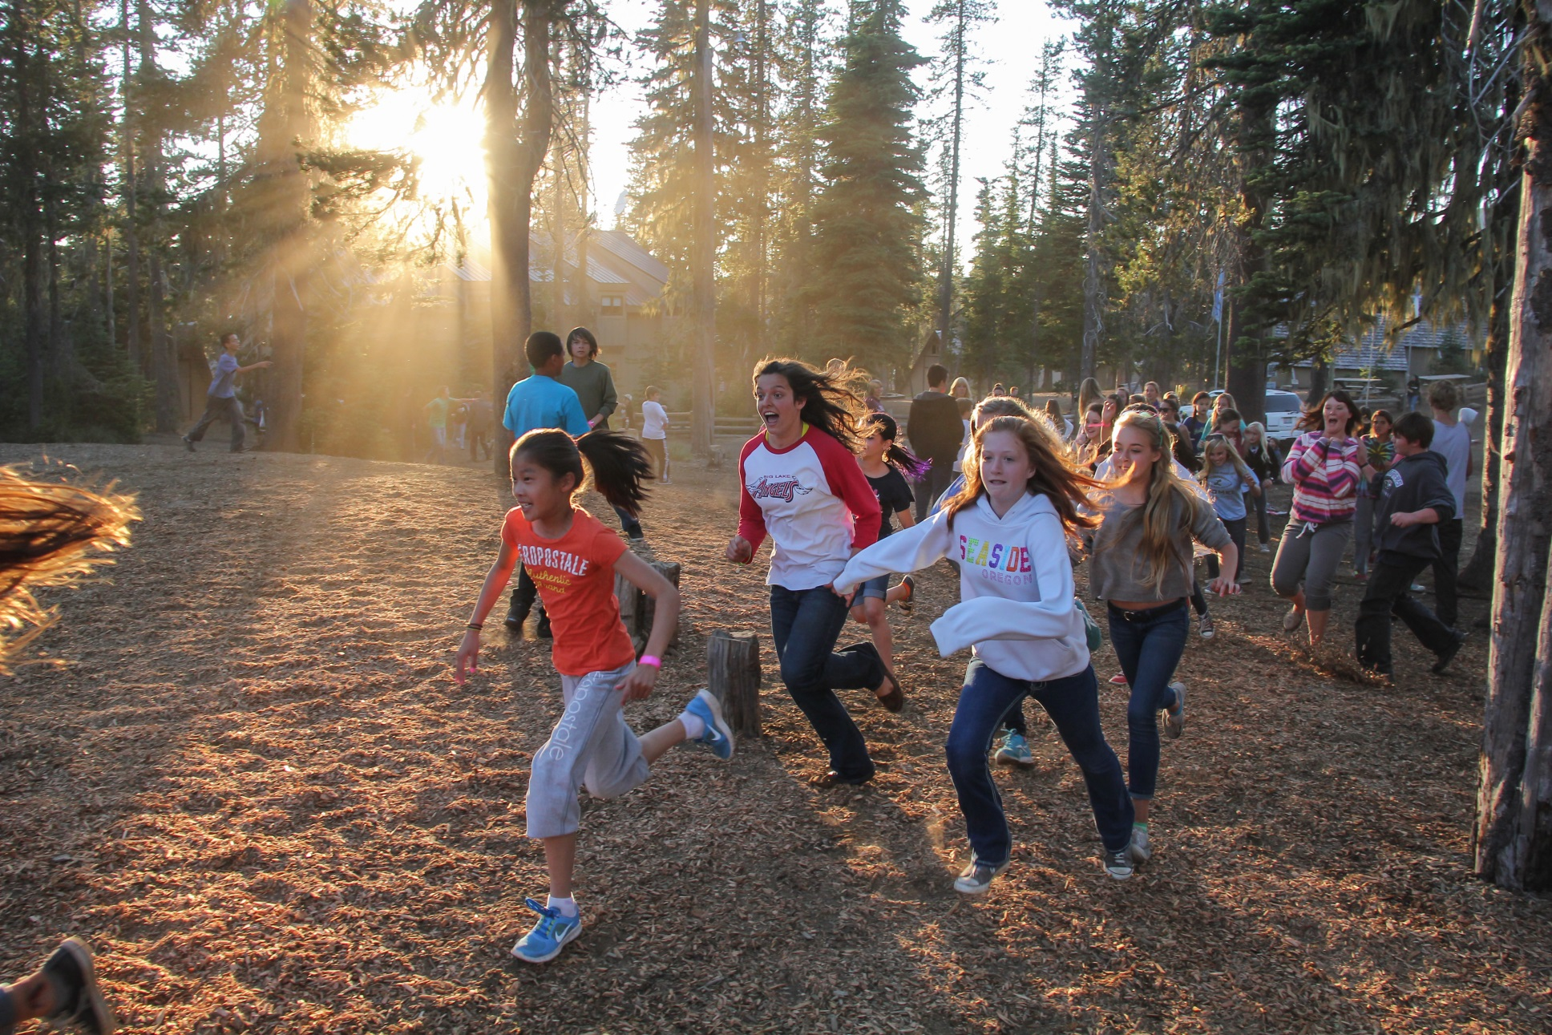
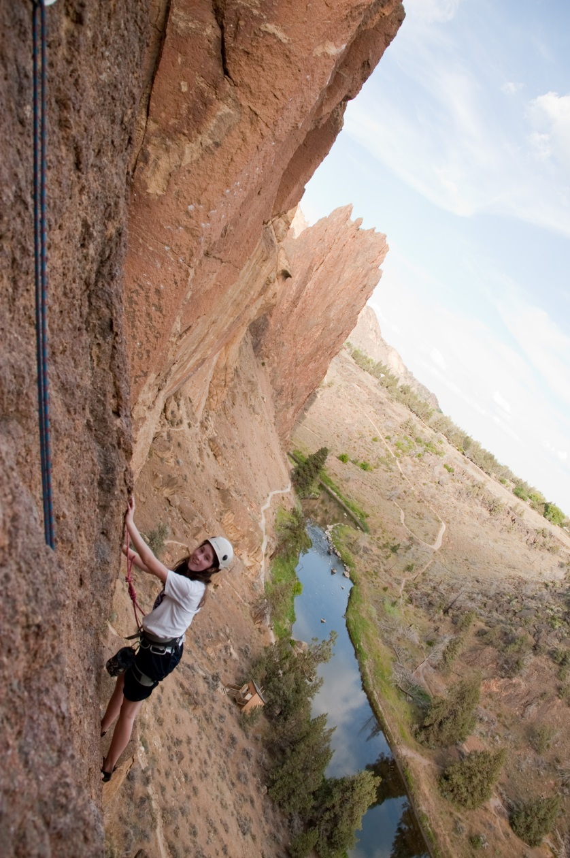
Reducing Hazards
Outdoors
Notes:
Discuss with your staff how can you reduce hazards outdoors, as they work and as they play with campers and co-workers.

Slide 9
PreventING Slips / trips / falls
If you notice a hazard, ACT!
Notes:
Invite the Camp Staff to be alert and aware of their surroundings. As they do, they should ACT immediately and clean up if they see water on the floors, cords, etc. and correct any other possible hazards that could cause slips, trips, and falls.

Slide 10
Examples of Summer Camp Workers Comp Records:
Repeat Use Painting & Moving Bark Chips (Wrist)
ATV Rollover. Elbow/Lower leg/Back (Motor Vehicle-roll over)
Playing Game, Fell Backwards Hit Head (Concussion/Brain)
Hydraulic Wood Wedge Pinch Left Thumb (Cut/Puncture By – Hand Tool/Powered (Laceration/Thumb)
Lifting Speakers/Microphones (Strain/Hernia by lifting)
Loading & Unloading 5 Tons of Hay (Strain/Shoulder(s)
Notes:
This list is taken from a Camp’s Workers’ Comp records’ of claims. Discuss examples that are relevant to your Camp.

Slide 11
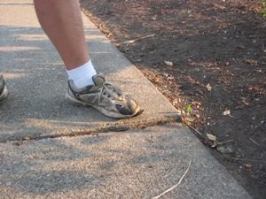
A few Tips to Prevent falls…
The best way to prevent falls is to always anticipate the potential hazard.

Slide 12
Wear good shoes and look ahead to where you are walking.

Slide 13
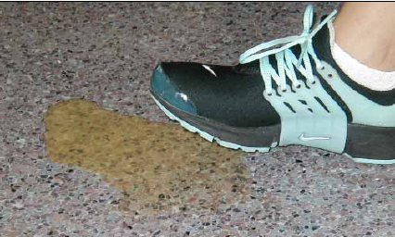
If you see ice, or liquid in a high-traffic area, take action. Clean it up! It might be obvious to you, but a person in a hurry or distressed may not notice.

Slide 14
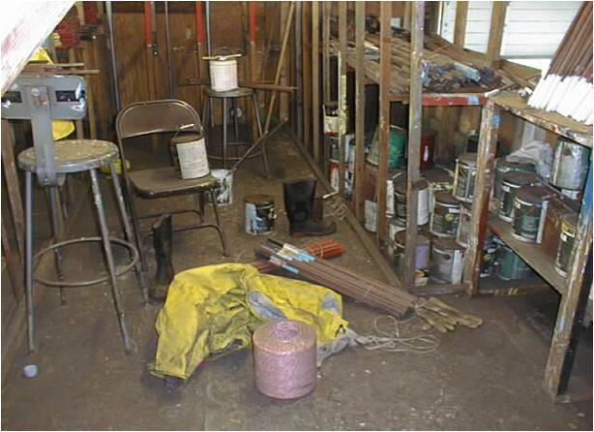
If you see clutter in a high-traffic area, take action. Clean it up!

Slide 15
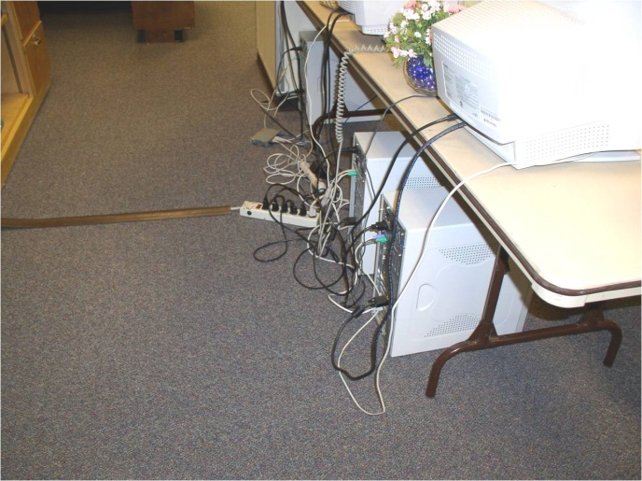
If you see hoses and power cords in a walking area… Clean it up!

Slide 16
Avoid wearing flip flops when working
Notes:
Refer this to your Camp’s Policy. You may review other Camp’s policies as needed.

Slide 17
Have a wonderful Summer!!

